Slide 1

Unit-5 Input-Output Organization
Computer System Architecture(CSA)
DU # 2101CS602
Prof. Vishal Kansagara
Computer Engineering Department
Vishal.kansagara@darshan.ac.in
8200601076

Slide 2

Outline
Input-output interface
Asynchronous Data Transfer
Modes Of Transfer
Priority Interrupt
DMA
Input-Output Processor (IOP)
Looping

Slide 3
Input-output interface
Section - 1

Slide 4
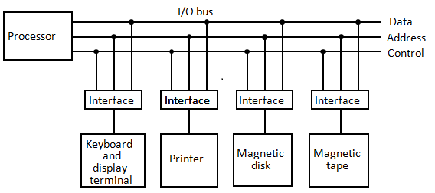
Peripherals, I/O Bus and Interface

Slide 5
Peripherals, I/O Bus and Interface
Peripherals: Input-output device attached to the computer are called peripherals.
The I/O bus consists of data lines, address lines, and control lines.
The magnetic disk, printer, display terminal and keyboard are employed in practically any general purpose computer.
Each peripheral device has associated with it an interface unit.
Each interface decodes the address and control received from the I/O bus, interprets them for the peripheral, and provides signals for the peripheral controller.
It also synchronizes the data flow and supervises the transfer between peripheral and processor.
Each peripheral has its own controller that operates the particular electromechanical device.
For example, the printer controller controls the paper motion, the print timing, and the selection of printing characters.

Slide 6
Peripherals, I/O Bus and Interface
The I/O bus from the processor is attached to all peripheral interfaces.
To communicate with a particular device, the processor places a device address on the address lines.
Each interface attached to the I/O bus contains an address decoder that monitors the address lines.
When the interface detects its own address, it activates the path between the bus lines and the device that it controls.
All peripherals whose address does not correspond to the address in the bus are disabled by their interface, and selected responds to the function code and proceeds to execute it.
The function code is referred to as an I/O command.
There are four types of commands that an interface may receive. They are classified as control, status, data output, and data input.

Slide 7
Peripherals, I/O Bus and Interface
A control command is issued to activate the peripheral and to inform it what to do.
For example, a magnetic tape unit may be instructed to backspace the tape by one record, to rewind the tape, or to start the tape moving in the forward direction.
A status command is used to test various status conditions in the interface and the peripheral.
For example, the computer may wish to check the status of the peripheral before a transfer is initiated.
During the transfer, one or more errors may occur which are detected by the interface.
These errors are designated by setting bits in a status register that the processor can read at certain intervals.
A data output command causes the interface to respond by transferring data from the bus into one of its registers.
The computer starts the tape moving by issuing a control command.

Slide 8
Peripherals, I/O Bus and Interface
The processor then monitors the status of the tape by means of a status command.
When the tape is in the correct position, the processor issues a data output command.
The interface responds to the address and command and transfers the information from the data lines in the bus to its buffer register.
The interface that communicates with the tape controller and sends the data to be stored on tape.
The data input command is the opposite of the data output.
In this case the interface receives an item of data from the peripheral and places it in its buffer register.
The processor checks if data are available by means of a status command and then issues a data input command.
The interface places the data on the data lines, where they are accepted by the processor.

Slide 9
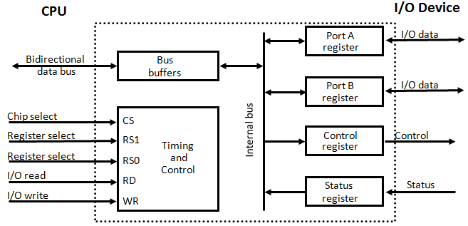
I/O interface
CS | RS1 | RS0 | Register Selected
0 | X | X | None: data bus in high impedance
1 | 0 | 0 | Port A register
1 | 0 | 1 | Port B register
1 | 1 | 0 | Control register
1 | 1 | 1 | Status register

Slide 10
I/O Interface
It consists of two data registers called ports, a control register, a status register, bus buffers, and timing and control circuit.
The interface communicates with the CPU through the data bus.
The chip select and register select inputs determine the address assigned to the interface.
The I/O read and writes are two control lines that specify an input or output, respectively.
The four registers communicate directly with the I/O device attached to the interface.
The I/O data to and from the device can be transferred into either port A or port B.
If the interface is connected to a printer, it will only output data, and if it services a character reader, it will only input data.
A magnetic disk unit transfers data in both directions but not at the same time, so the interface can use bidirectional lines.
A command is passed to the I/O device by sending a word to the appropriate interface register.

Slide 11
I/O Interface
The control register receives control information from the CPU. By loading appropriate bits into the control register, the interface and the I/O device attached to it can be placed in a variety of operating modes.
For example, port A may be defined as an input port and port B as an output port.
A magnetic tape unit may be instructed to rewind the tape or to start the tape moving in the forward direction.
The bits in the status register are used for status conditions and for recording errors that may occur during the data transfer.
For example, a status bit may indicate that port A has received a new data item from the I/O device.
Another bit in the status register may indicate that a parity error has occurred during the transfer.
The interface registers communicate with the CPU through the bidirectional data bus.

Slide 12
I/O Interface
The address bus selects the interface unit through the chip select and the two register select inputs.
A circuit must be provided externally (usually, a decoder) to detect the address assigned to the interface registers.
This circuit enables the chip select (CS) input when the interface is selected by the address bus.
The two register select inputs RS1 and RS0 are usually connected to the two least significant lines of the address bus.
These two inputs select one of the four registers in the interface as specified in the table accompanying the diagram.
The content of the selected register is transfer into the CPU via the data bus when the I/O read signal is enables.
The CPU transfers binary information into the selected register via the data bus when the I/O write input is enabled.

Slide 13
Asynchronous Data Transfer
Section - 1

Slide 14
Asynchronous Data Transfer
Asynchronous data transfer between two independent units requires that control signals be transmitted between the communicating units to indicate the time at which data is being transmitted.
Two ways of achieving
Strobe
Handshaking

Slide 15
Strobe Method
1.1 Source initiated Strobe
1.2 Destination initiated Strobe
Source unit
Data Bus
Destination unit
Data Bus
Destination unit
Source unit
Strobe
Strobe
Data
Valid Data
Data
Valid Data
Strobe
Strobe

Slide 16
2.1 Source initiated Handshake
Source unit
Destination unit
Data bus
Source unit
Destination unit
Data valid
Place data on bus.
Enable data valid.
Data accepted
Accept data from bus.
Enable data accepted.
Valid Data
Data bus
Disable data valid.
Invalidate data on bus.
Data valid
Disable data accepted.
Ready to accept data (initial state).
Data accepted

Slide 17
2.2 Destination initiated Handshake
Data bus
Source unit
Destination unit
Data valid
Source unit
Destination unit
Ready for data
Ready to accept data.
Enable Ready for data.
Place data on bus.
Enable data valid.
Ready for data
Accept data from bus.
Disable Ready for data.
Data valid
Disable data valid.
Invalid data on bus
(initial state).
Valid Data
Data bus

Slide 18
Asynchronous Serial Transfer
Rules for transmission
When a character is not being sent, the line is kept in the 1-state.
The initiation of a character transmission is detected from the start bit, which is always 0.
The character bits always follow the start bit.
After the last bit of the character is transmitted, a stop bit is detected when the line returns to the 1-state for at least one bit time.
1
1
0
0
0
1
0
1
Start
bit
Character bit
Stop
bits

Slide 19
Modes Of Transfer
Section - 2

Slide 20
Modes of Transfer
Data transfer between the central computer and I/O devices may be handled in a variety of modes.
Some modes use the CPU as an intermediate path; others transfer the data directly to and from the memory unit.
Data transfer to and from peripherals may be handled in one of three possible modes:
Programmed I/O
Interrupt-initiated I/O
Direct memory access (DMA)

Slide 21
Programmed I/O
Read Status register
Check flag bit
= 0
Flag
CPU
Data bus
Interface
I/O
device
I/O bus
= 1
Address bus
Data register
Data valid
Read Data register
I/O read
I/O write
Status register
F
Data accepted
Transfer data to memory
Operation complete?
no
yes
Continue with program

Slide 22
Interrupt-initiated I/O
An alternative to the CPU constantly monitoring the flag is to let the interface inform the computer when it is ready to transfer data.
While the CPU is running a program, it does not check the flag.
However, when the flag is set, the computer is momentarily interrupted from proceeding with current program and is informed of the fact that the flag has been set.
The CPU deviates from what it is doing to take care of the input or output transfer.
After the transfer is completed, the computer returns to the previous program to continue what it was doing before the interrupt.

Slide 23
Priority Interrupt
Section - 3

Slide 24
Priority Interrupt (Daisy-Chaining Technique)
Determines which interrupt is to be served first when two or more requests are made simultaneously
Also determines which interrupts are permitted to interrupt the computer while another is being serviced.
Higher priority interrupts can make requests while servicing a lower priority interrupt.
Processor data bus
VAD 1
VAD 2
VAD 3
Device 1
Device 2
Device 3
PI
PO
PI
PO
PI
PO
To next
device
Interrupt request
INT
CPU
Interrupt acknowledge
INTACK

Slide 25
DMA (Direct Memory Access)
Section - 4

Slide 26
DMA (Direct Memory Access)
The transfer of data between a fast storage device such as magnetic disk and memory is often limited by the speed of the CPU.
Removing the CPU from the path and letting the peripheral device manage the memory buses directly would improve the speed of transfer.
This transfer technique is called direct memory access (DMA).
During DMA, CPU is idle and has no control of the memory buses.
A DMA controller takes over the buses to manage the transfer directly between the I/O device and memory.
ABUS
Address bus
High-impedance (disabled) when BG is enabled
Bus request
BR
DBUS
Data bus
CPU
RD
Read
Bus granted
BG
WR
Write

Slide 27
DMA Controller
DMA Controller
DMA controller - Interface which allows I/O transfer directly between Memory and Device, freeing CPU for other tasks
CPU initializes DMA Controller by sending memory address and the block size (number of words).
Address bus
Data bus
Data bus buffers
Address bus buffers
Address register
DMA Select
DS
Internal Bus
Register select
RS
Word count register
Read
RD
Control logic
Control register
Write
WR
Bus request
BR
Bus grant
BG
DMA Request
Interrupt
Interrupt
DMA Acknowledge
to I/O device

Slide 28
Input-Output Processor (IOP)
Section - 5

Slide 29
Input-Output Processor (IOP)
Central Processing Unit (CPU)
Peripheral Device
Memory Unit
Memory Bus
PD
PD
PD
PD
Input-Output Processor
I/O Bus

Slide 30
CPU operations
IOP operations
CPU – IOP Communication
Send instruction to test IOP path
Transfer status word to memory location
If status OK, send start I/O instruction to IOP
Access memory for IOP program
CPU continues with another program
Conduct I/O transfers using DMA; prepare status report
I/O transfer completed; interrupt CPU
Request IOP status
Transfer status word to memory location
Check status word for correct transfer
Continue

Slide 31
Thank you


